Slide 1
Trading Algorithm Presentation
Lang (Ron) Chen, Yihang (Eric) Lu, Zetian (Jacky) Lyu, Didi (Di) Wu

Slide 2


Team
Lang (Ron) Chen
UniMelb – Penultimate Year Master of Data Science
Supervised Machine Learning, Hyperparameter Tuning, Finance
Yihang (Eric) Lu
UniMelb – Penultimate Year Master of Mathematics and Statistics
Research in Bayesian Variable Selection Methods
Zetian (Jacky) Lyu
UNSW – Honours in
Didi (Di) Wu
UniMelb – Final Year Bachelor of Science majoring in Data Science

Slide 3
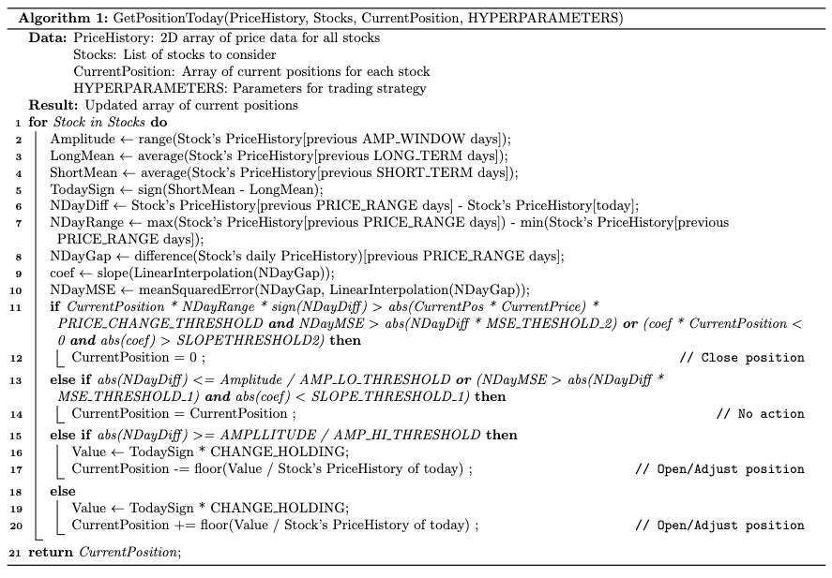
The Algorithm
Close Position Module
Open/Adjust Position Module

Slide 4
Backtesting Results
Best Hyperparameter Set (Prioritising Temporal Generalisability)
Ablation Study (without Close Position Mechanism)
Best of Each Period
 | Average(D100-D350, D200-D450, … , D400-D650) | D250-D500 | D500-D750
Score | 30.69 | 27.45 | 17.51
Mean | 43.95 | 41.4 | 29.8
Std | 132.58 | 139.27 | 123.23
Return | 0.34% | 0.32% | 0.22%
AnnualisedSharpe | 5.24 | 4.7 | 3.83
Score | 24.54 | 4.06 | 18.01
Score | 34.27 | 29.62 | 49.57

Slide 5


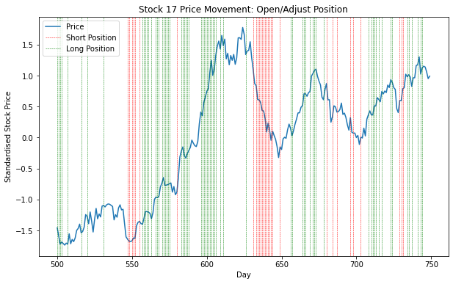
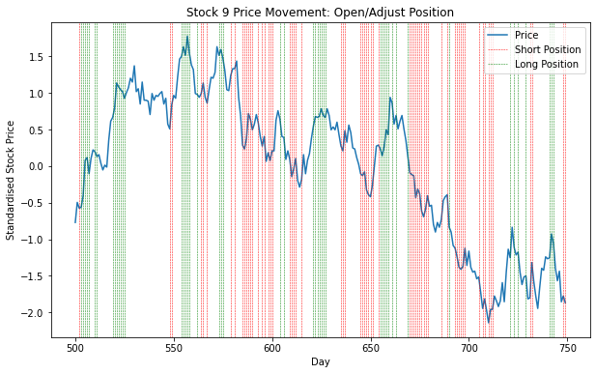
Discussion: Open/ADJUST Position Module

Slide 6
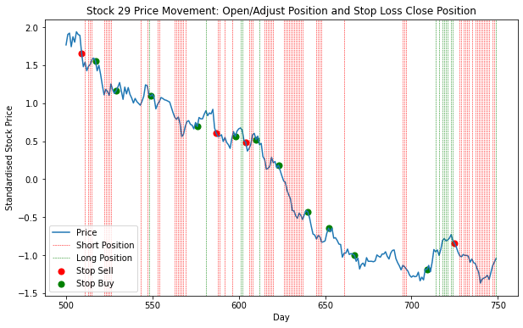
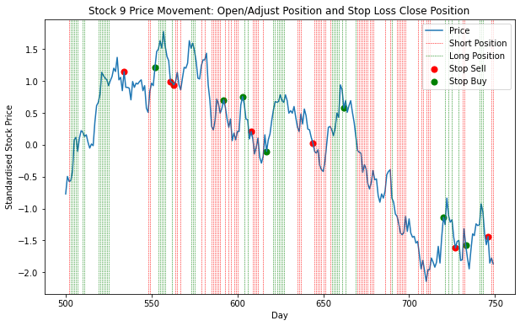
Discussion: ClosE Position Module

Slide 7
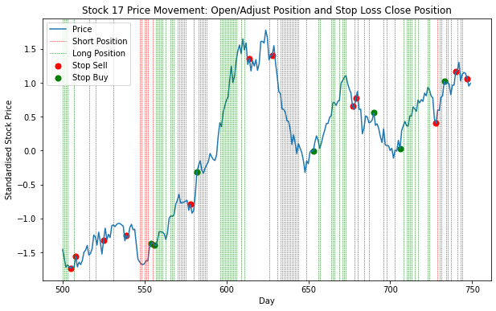
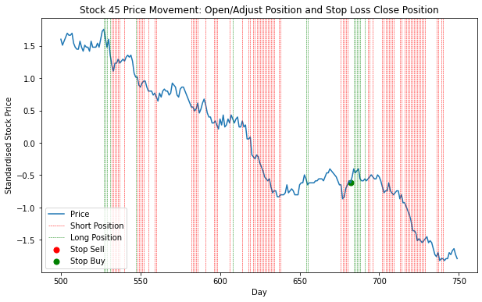
Discussion: Complete system

Slide 8
Other attempts
Strategy | Details | Reason of Failure
Trade on Predicted Log Return = log(P_{t+1}/P_{t}) | Regression model trained on engineered features (i.e. Long Short Term Memory, Dense Neural Network, Light Gradient Boost …) | R² of models never statistically significantly positive
Trade on Predicted Binary Trend = I(P_{t+1}>P_{t}) | Classifier model trained on engineered features (i.e. Same as above + Support Vector Machine, Logistic Regression) | Near 50% accuracy for most models; LSTM achieved 60% accuracy but trading still made loss
Pairs Trading | Perform Mean Reversion on Cointegrated Pairs | Made Loss
Bollinger Bands | Short if P_{t} ≥ UpperBound, Long if P_{t} ≤ LowerBound | Made Loss
Bollinger Bands – Moving Average | Same as above, and close position if price crossed MA | Made Loss
Short Long MA Crossover | Long if Short Term MA cuts Long Term MA from below, etc | Made Loss

Slide 9
Appendix: Hyperparameters of Algorithm
HYPERPARAMETER | Value | HYPERPARAMETER | Value
SHORT_TERM | 4 | AMP_HI_THRESHOLD | 1
LONG_TERM | 15 | MSE_THRESHOLD_1 | 0.05
PRICE_RANGE | 7 | SLOPE_THRESHOLD_1 | 0.05
AMP_WINDOW | 75 | MSE_THRESHOLD_2 | 0.04
CHANGE_HOLDING | 500 | SLOPE_THRESHOLD_2 | 2
AMP_LO_THRESHOLD | 7.5 | PRICE_CHANGE_THRESHOLD | 0.01

